Slide 1
Lecture 3: Numerical Differentiation & Integration
Omer Bromberg
omerbr@tauex.tau.ac.il
Winter 2025/6
Modified from lecture notes by Cyrus Dreyer & Michael Zingale

Slide 2
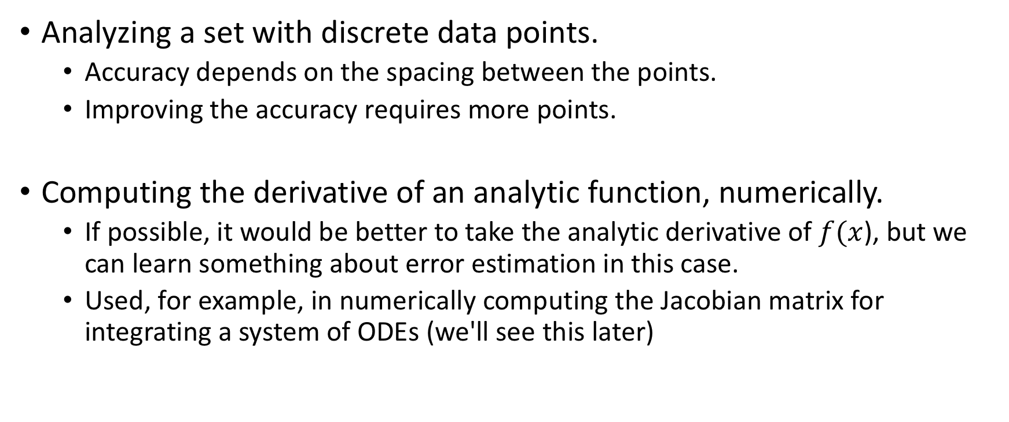
Numerical differentiation, Two situations:
Analyzing a set with discrete data points.
Accuracy depends on the spacing between the points.
Improving the accuracy requires more points.
Computing the derivative of an analytic function, numerically.
If possible, it would be better to take the analytic derivative of $f(x$), but we can learn something about error estimation in this case.
Used, for example, in numerically computing the Jacobian matrix for integrating a system of ODEs (we'll see this later)

Slide 3
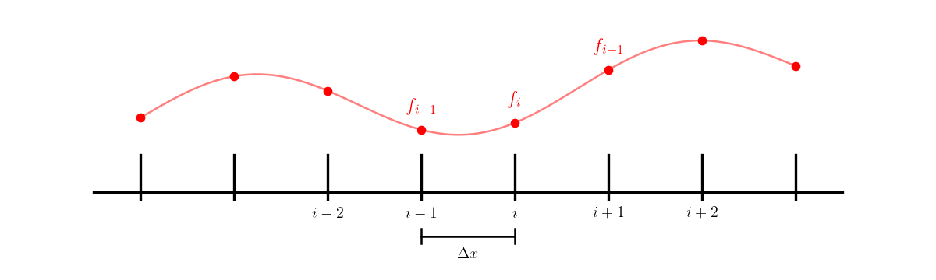
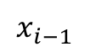
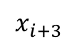
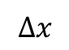
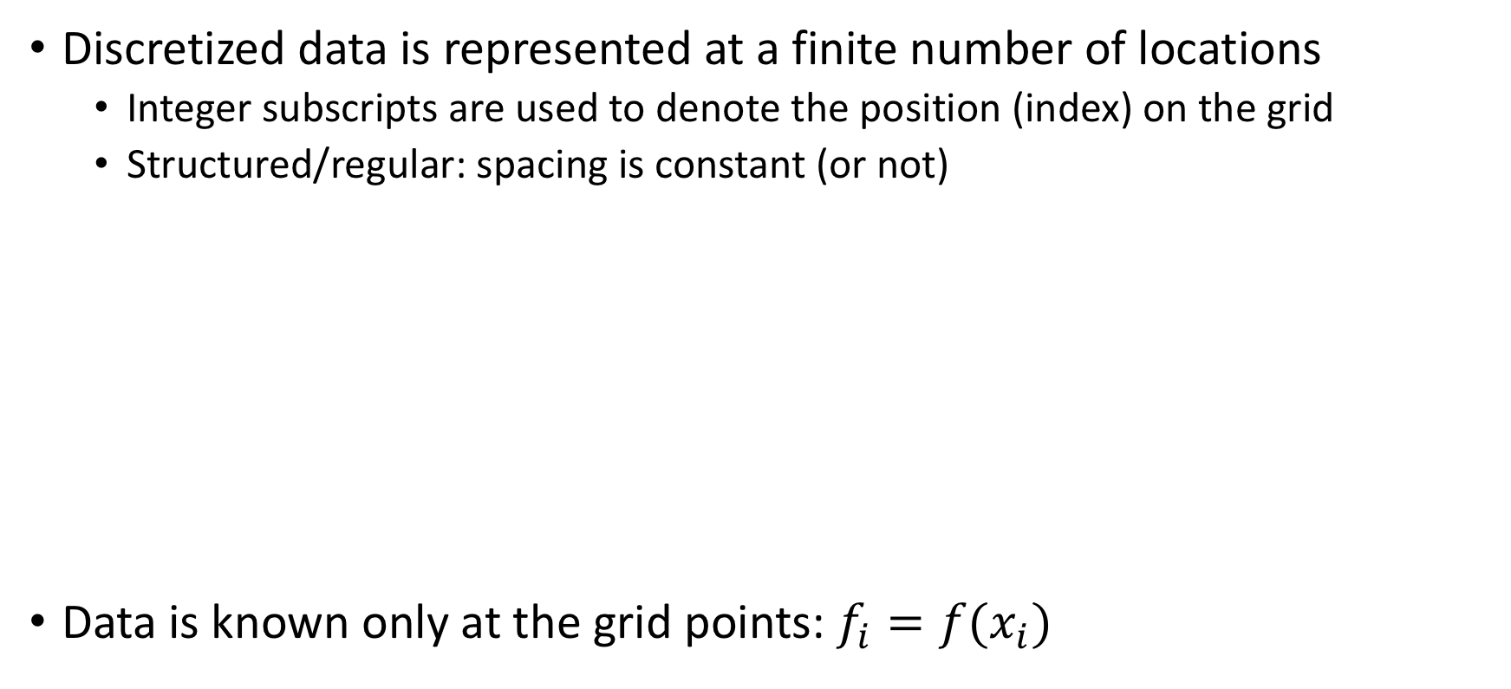
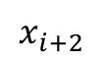
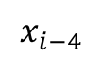
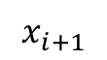
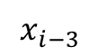
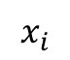
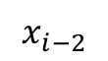
Gridded data
Discretized data is represented at a finite number of locations
Integer subscripts are used to denote the position (index) on the grid
Structured/regular: spacing is constant (or not)
Data is known only at the grid points: $f_{i}=f(x_{i})$
$$x_{i−4}$$
$$x_{i−3}$$
$$x_{i−2}$$
$$x_{i−1}$$
$$x_{i}$$
$$x_{i+1}$$
$$x_{i+2}$$
$$x_{i+3}$$
$$Δx$$

Slide 4
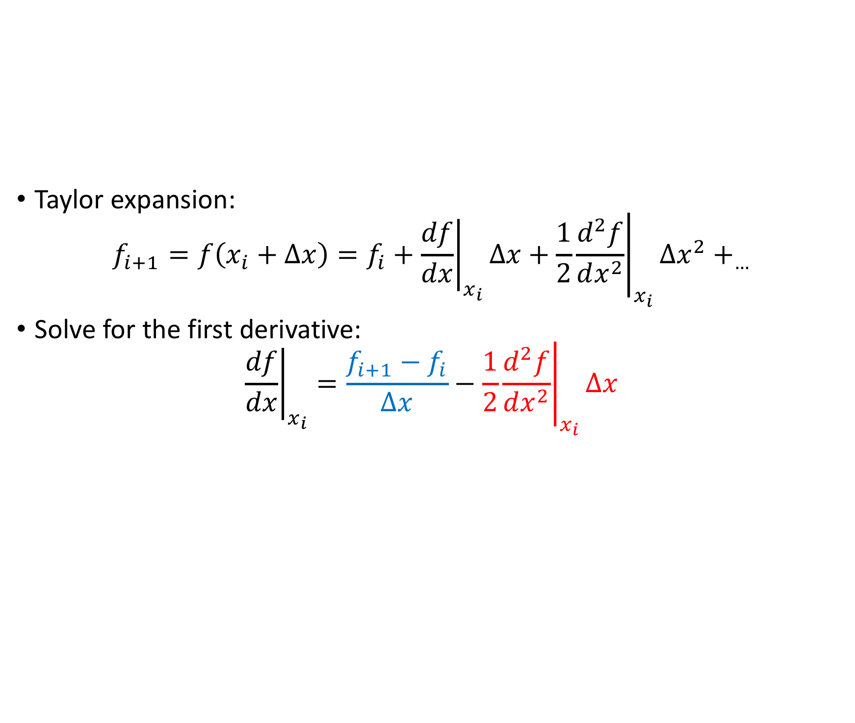
First derivative
Taylor expansion:
$$f_{i+1}=f\left(x_{i}+Δx\right)=f_{i}+{\left.\frac{df}{dx}\right|}_{x_{i}}Δx+\frac{1}{2}{\left.\frac{d^{2}f}{dx^{2}}\right|}_{x_{i}}Δx^{2}+_{…}$$
Solve for the first derivative:
$${\left.\frac{df}{dx}\right|}_{x_{i}}=\frac{f_{i+1}−f_{i}}{Δx}−\frac{1}{2}{\left.\frac{d^{2}f}{dx^{2}}\right|}_{x_{i}}Δx$$
Discrete approximation
Leading term of truncation error

Slide 5
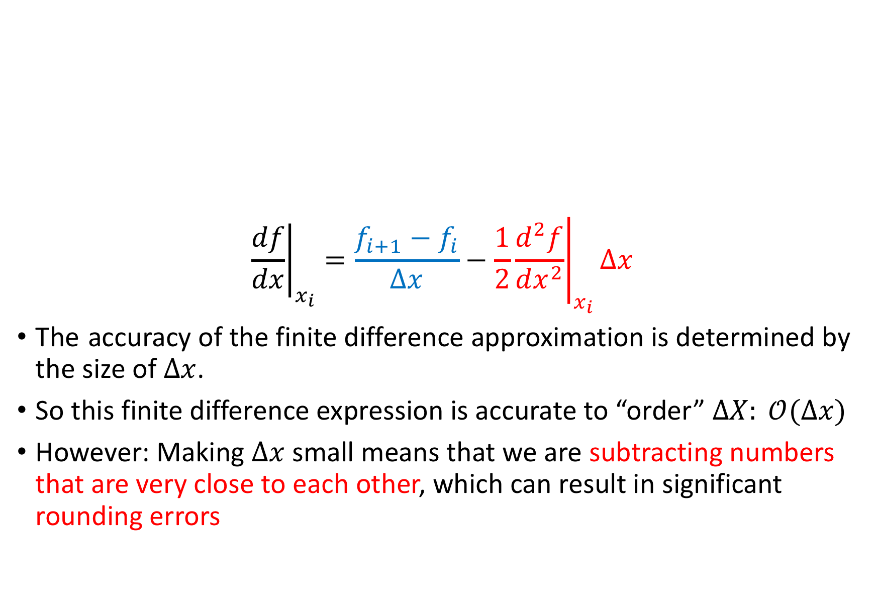
Order of accuracy
$${\left.\frac{df}{dx}\right|}_{x_{i}}=\frac{f_{i+1}−f_{i}}{Δx}−\frac{1}{2}{\left.\frac{d^{2}f}{dx^{2}}\right|}_{x_{i}}Δx$$
The accuracy of the finite difference approximation is determined by the size of $Δx$.
So this finite difference expression is accurate to “order” $ΔX: 𝒪(Δx)$
However: Making $Δx$ small means that we are subtracting numbers that are very close to each other, which can result in significant rounding errors

Slide 6
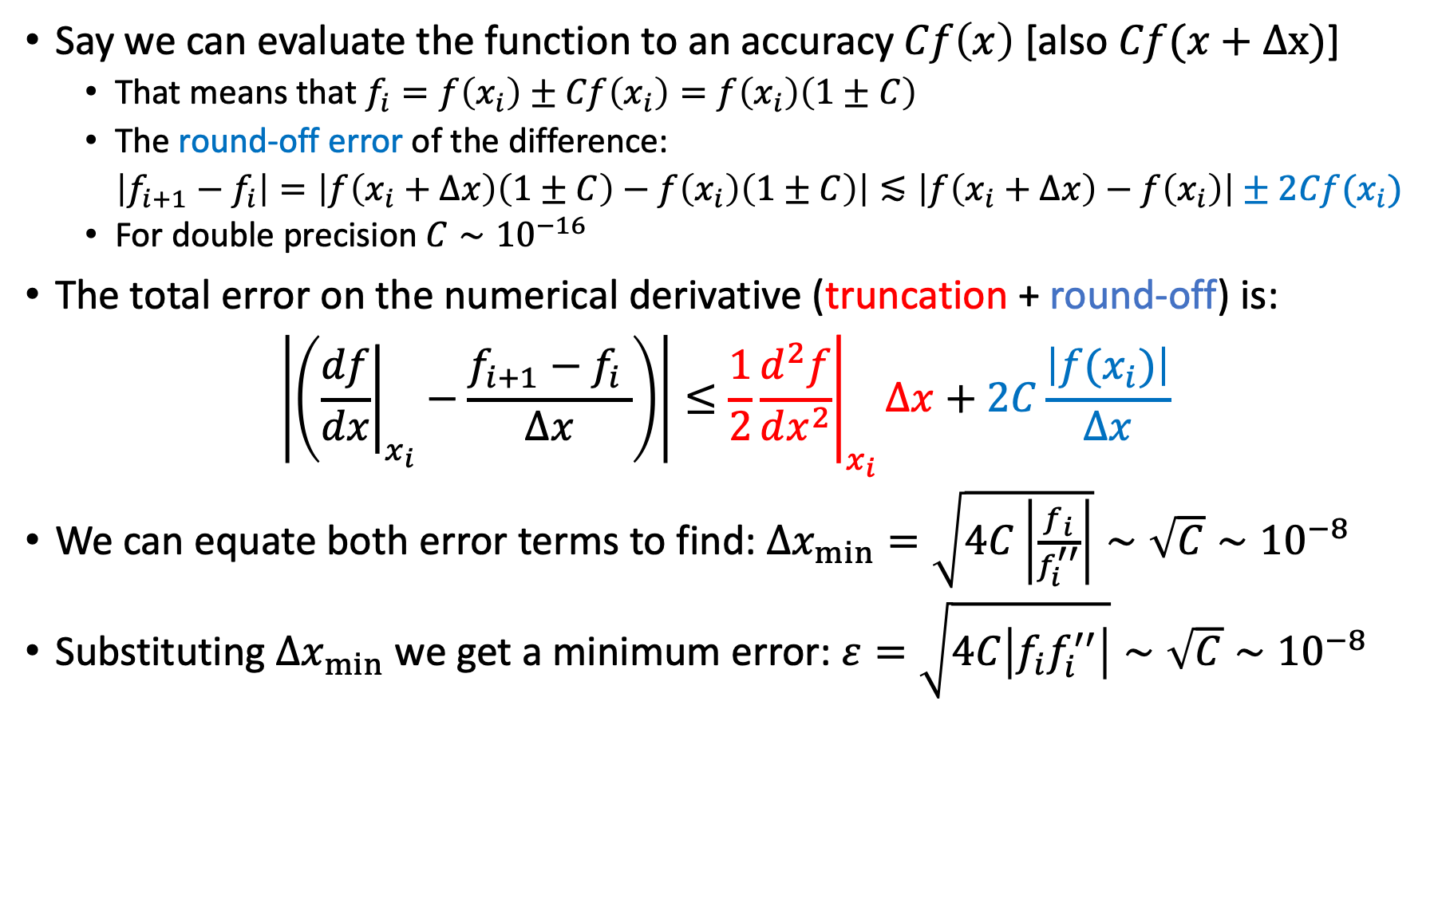
Estimating the error
Say we can evaluate the function to an accuracy $Cf\left(x\right)$ [also $Cf(x+Δx)$]
That means that $f_{i}=f\left(x_{i}\right)±Cf\left(x_{i}\right)=f\left(x_{i}\right)\left(1±C\right)$
The round-off error of the difference:
$\left|f_{i+1}−f_{i}\right|=\left|f\left(x_{i}+Δx\right)\left(1±C\right)−f\left(x_{i}\right)\left(1±C\right)\right|≲\left|f\left(x_{i}+Δx\right)−f\left(x_{i}\right)\right|±2Cf(x_{i})$
For double precision $C∼{10}^{−16}$
The total error on the numerical derivative (truncation + round-off) is:
$$\left|\left({\left.\frac{df}{dx}\right|}_{x_{i}}−\frac{f_{i+1}−f_{i} }{Δx}\right)\right|≤\frac{1}{2}{\left.\frac{d^{2}f}{dx^{2}}\right|}_{x_{i}}Δx+2C\frac{\left|f(x_{i})\right|}{Δx}$$
We can equate both error terms to find: $Δx_{min}=\sqrt{4C\left|\frac{f_{i}}{f_{i}^{′′}}\right|}∼\sqrt{C}∼{10}^{−8}$
Substituting $Δx_{min}$ we get a minimum error: $ε=\sqrt{4C\left|{f_{i}f}_{i}^{′′}\right|}∼\sqrt{C}∼{10}^{−8}$
Notes:
To evaluate Delta x _ min, we compare the truncation to the roundoff error, the logic is that the truncation error drops smaller delta x while the roundoff error increases. So the sweet spot will be where both are equal.
the minimal error is obtained by substituting Delta x min in the expression, to obtain an error that is a square of C, so for small roundoff errors the total error is actially larger.

Slide 7
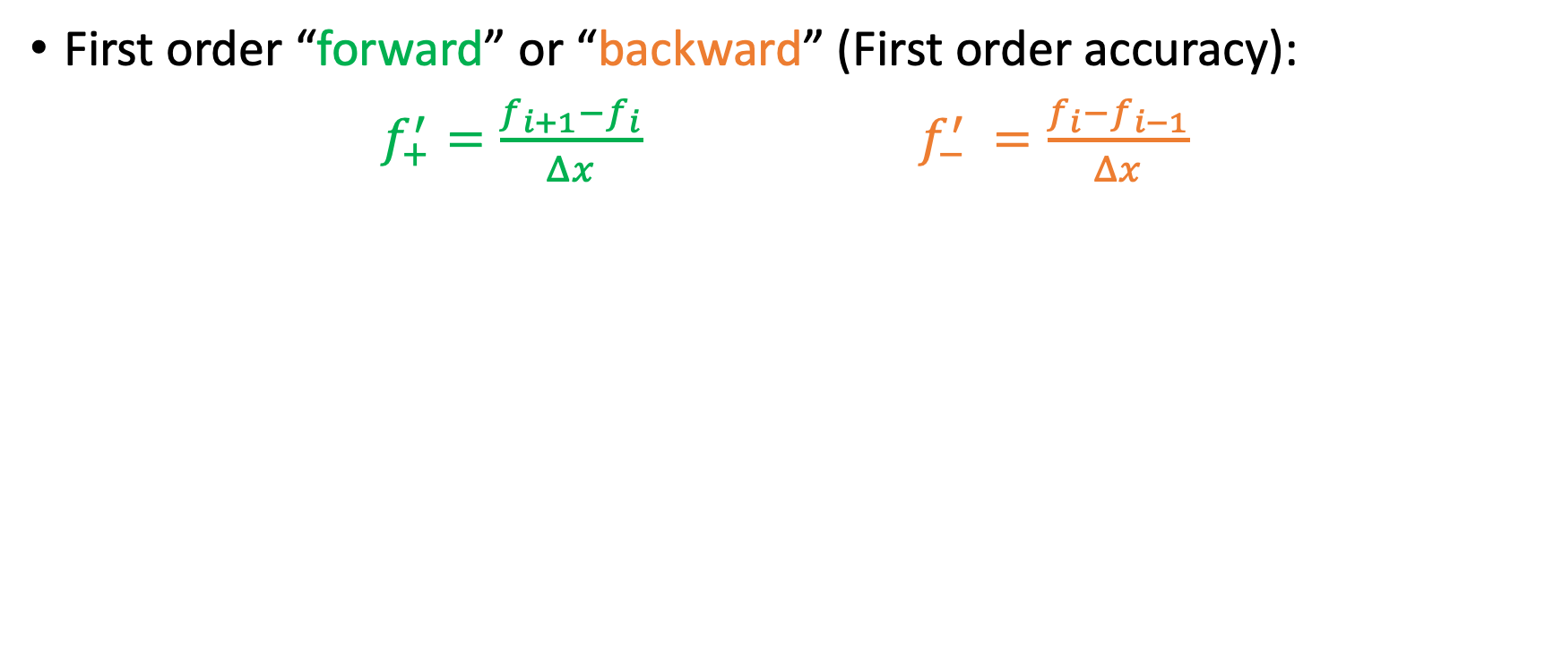
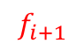
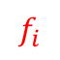
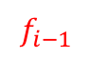
Increasing the accuracy - using more points
First order “forward” or “backward” (First order accuracy):
$f_{+}^{′}=\frac{f_{i+1}−f_{i}}{Δx}$ $f_{−}^{′} =\frac{f_{i}−f_{i−1}}{Δx}$
2-point stencil
$$f_{i+1}$$
$$f_{i−1}$$
$$f_{i}$$

Slide 8

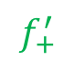
Increasing the accuracy - using more points
First order “forward” or “backward” (First order accuracy):
$f_{+}^{′}=\frac{f_{i+1}−f_{i}}{Δx}$ $f_{−}^{′} =\frac{f_{i}−f_{i−1}}{Δx}$
2-point stencil
$$f_{i+1}$$
$$f_{+}^{′}$$
$$f_{i−1}$$
$$f_{−}^{′}$$
$$f_{i}$$

Slide 9
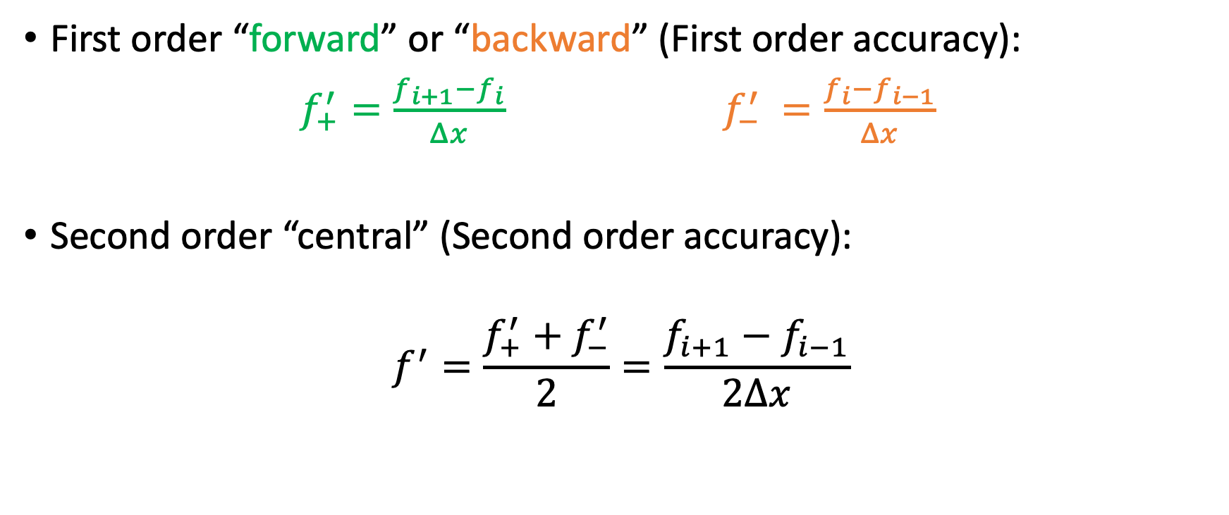
Increasing the accuracy - using more points
First order “forward” or “backward” (First order accuracy):
$f_{+}^{′}=\frac{f_{i+1}−f_{i}}{Δx}$ $f_{−}^{′} =\frac{f_{i}−f_{i−1}}{Δx}$
Second order “central” (Second order accuracy):
$$f^{′}=\frac{f_{+}^{′}+f_{−}^{′}}{2}=\frac{f_{i+1}−f_{i−1}}{2Δx}$$
2-point stencil
3-point stencil
$$f_{i+1}$$
$$f_{+}^{′}$$
$$f_{i−1}$$
$$f_{−}^{′}$$
$$f_{i}$$

Slide 10
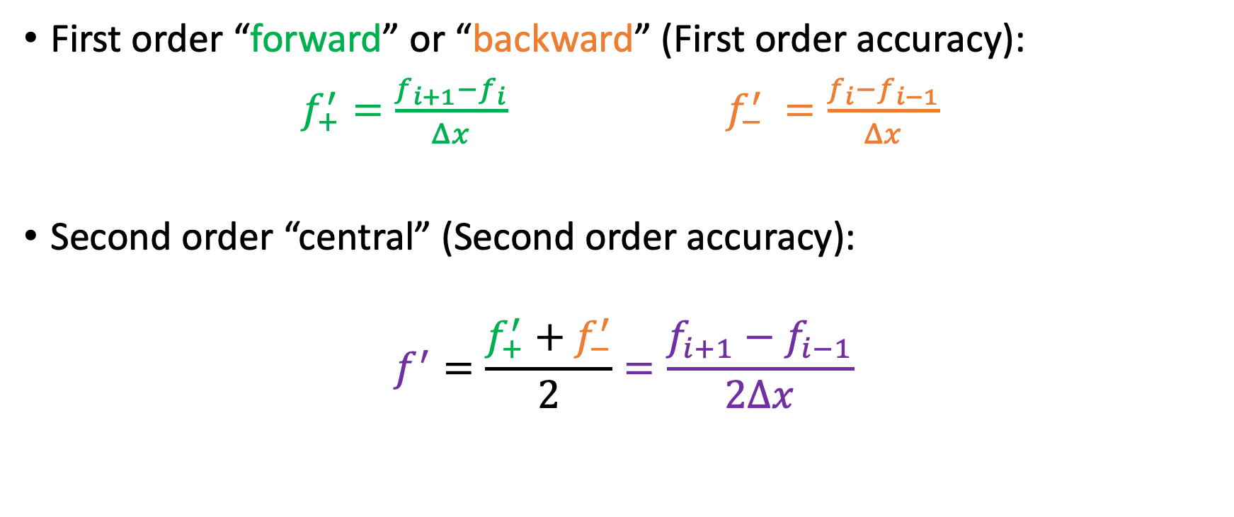
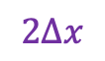
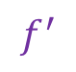
Increasing the accuracy - using more points
First order “forward” or “backward” (First order accuracy):
$f_{+}^{′}=\frac{f_{i+1}−f_{i}}{Δx}$ $f_{−}^{′} =\frac{f_{i}−f_{i−1}}{Δx}$
Second order “central” (Second order accuracy):
$$f^{′}=\frac{f_{+}^{′}+f_{−}^{′}}{2}=\frac{f_{i+1}−f_{i−1}}{2Δx}$$
2-point stencil
3-point stencil
$$f_{i+1}$$
$$f_{+}^{′}$$
$$f_{−}^{′}$$
$$f^{′}$$
$$f_{i−1}$$
$$f_{i}$$
$$2Δx$$

Slide 11
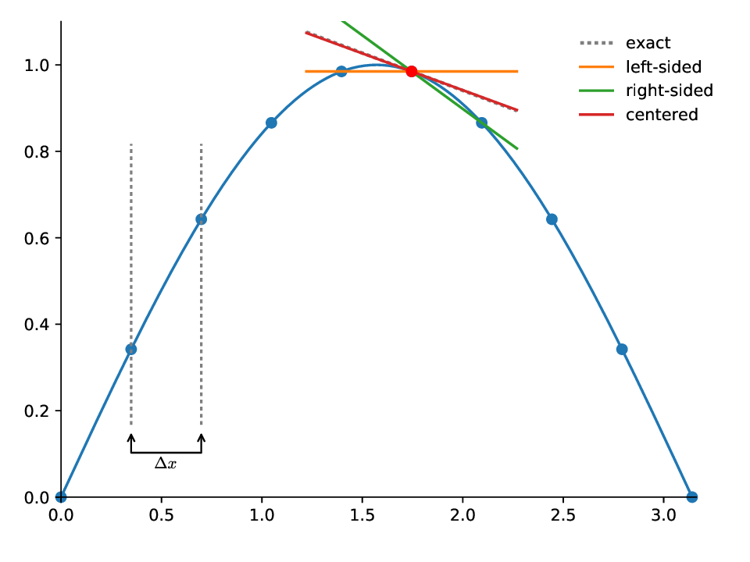
Increasing the accuracy - using more points
exact
left-side
right-side
centered
https://zingale.github.io/computational_astrophysics/basics/diff-int/differentiation.html

Slide 12
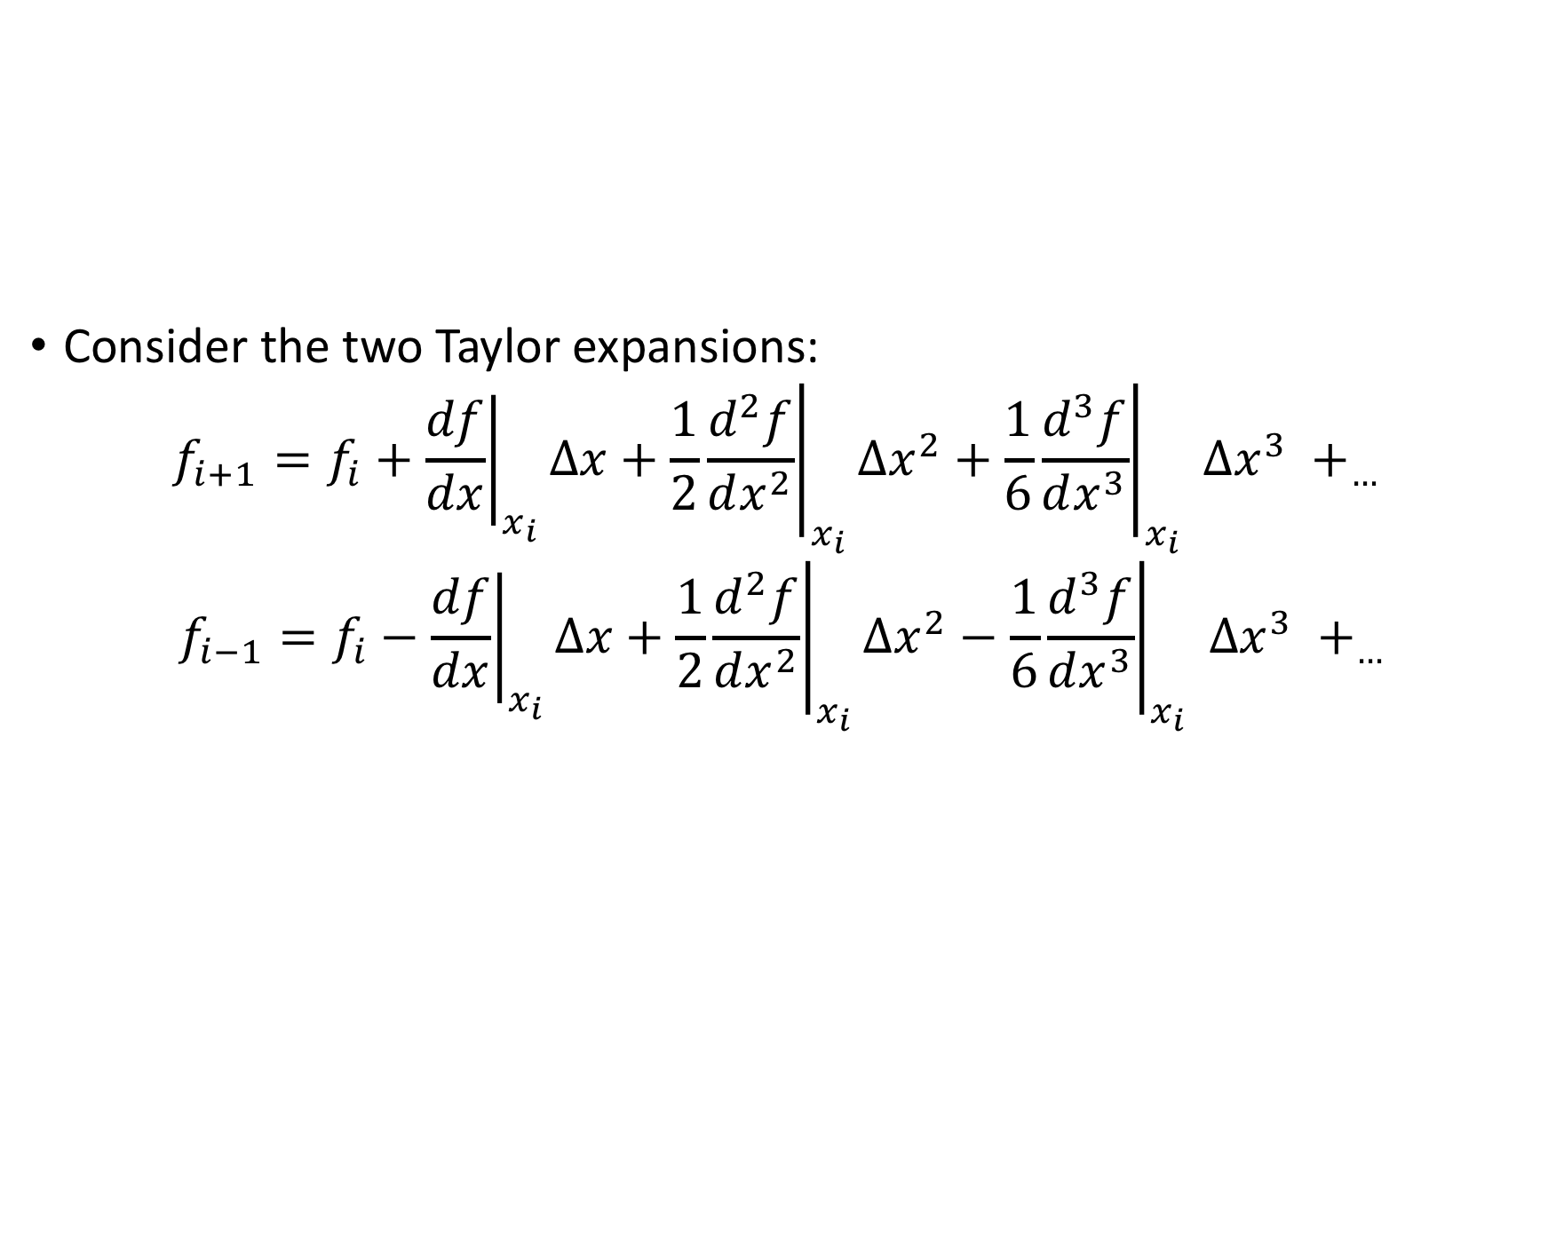
Order of accuracy in first order central derivative
Consider the two Taylor expansions:
$${f_{i+1}=f}_{i}+{\left.\frac{df}{dx}\right|}_{x_{i}}Δx+\frac{1}{2}{\left.\frac{d^{2}f}{dx^{2}}\right|}_{x_{i}}Δx^{2}+\frac{1}{6}{\left.\frac{d^{3}f}{dx^{3}}\right|}_{x_{i}} Δx^{3} +_{…}$$
$${f_{i−1}=f}_{i}−{\left.\frac{df}{dx}\right|}_{x_{i}}Δx+\frac{1}{2}{\left.\frac{d^{2}f}{dx^{2}}\right|}_{x_{i}}Δx^{2}−\frac{1}{6}{\left.\frac{d^{3}f}{dx^{3}}\right|}_{x_{i}} Δx^{3} +_{…}$$

Slide 13
Order of accuracy in first order central derivative
Consider the two Taylor expansions:
$${f_{i+1}=f}_{i}+{\left.\frac{df}{dx}\right|}_{x_{i}}Δx+\frac{1}{2}{\left.\frac{d^{2}f}{dx^{2}}\right|}_{x_{i}}Δx^{2}+\frac{1}{6}{\left.\frac{d^{3}f}{dx^{3}}\right|}_{x_{i}} Δx^{3} +_{…}$$
$${f_{i−1}=f}_{i}−{\left.\frac{df}{dx}\right|}_{x_{i}}Δx+\frac{1}{2}{\left.\frac{d^{2}f}{dx^{2}}\right|}_{x_{i}}Δx^{2}−\frac{1}{6}{\left.\frac{d^{3}f}{dx^{3}}\right|}_{x_{i}} Δx^{3} +_{…}$$
-

Slide 14
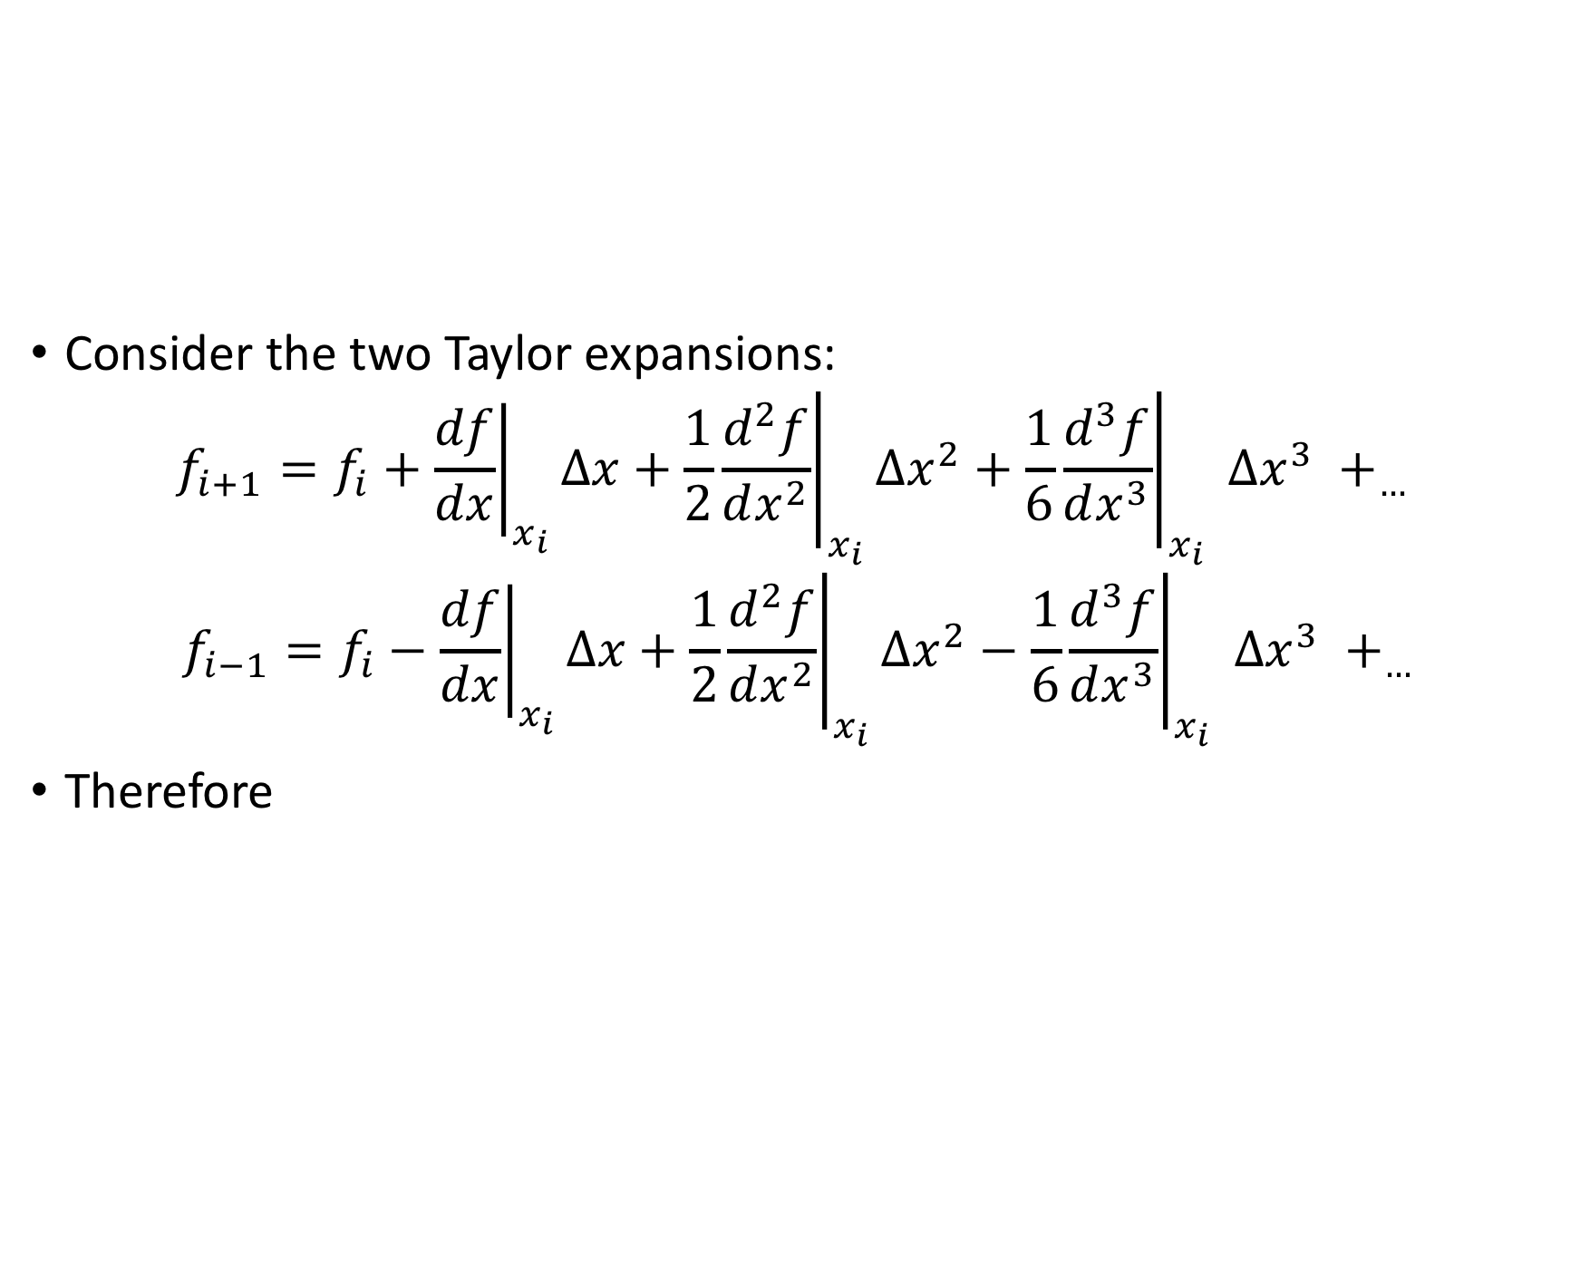
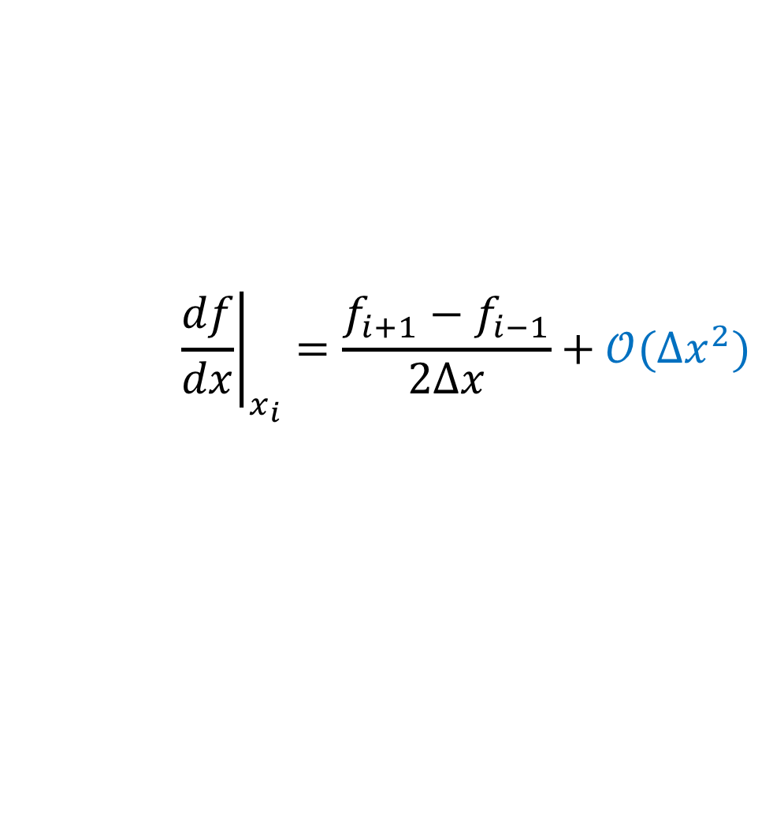
Order of accuracy in first order central derivative
Consider the two Taylor expansions:
$${f_{i+1}=f}_{i}+{\left.\frac{df}{dx}\right|}_{x_{i}}Δx+\frac{1}{2}{\left.\frac{d^{2}f}{dx^{2}}\right|}_{x_{i}}Δx^{2}+\frac{1}{6}{\left.\frac{d^{3}f}{dx^{3}}\right|}_{x_{i}} Δx^{3} +_{…}$$
$${f_{i−1}=f}_{i}−{\left.\frac{df}{dx}\right|}_{x_{i}}Δx+\frac{1}{2}{\left.\frac{d^{2}f}{dx^{2}}\right|}_{x_{i}}Δx^{2}−\frac{1}{6}{\left.\frac{d^{3}f}{dx^{3}}\right|}_{x_{i}} Δx^{3} +_{…}$$
Therefore
-
$${\left.\frac{df}{dx}\right|}_{x_{i}}=\frac{f_{i+1}−f_{i−1}}{2Δx}+𝒪(Δx^{2})$$
Notes:
the truncation error now is O(delta x)^3 / Delrfa x = O(Delta x)^2

Slide 15
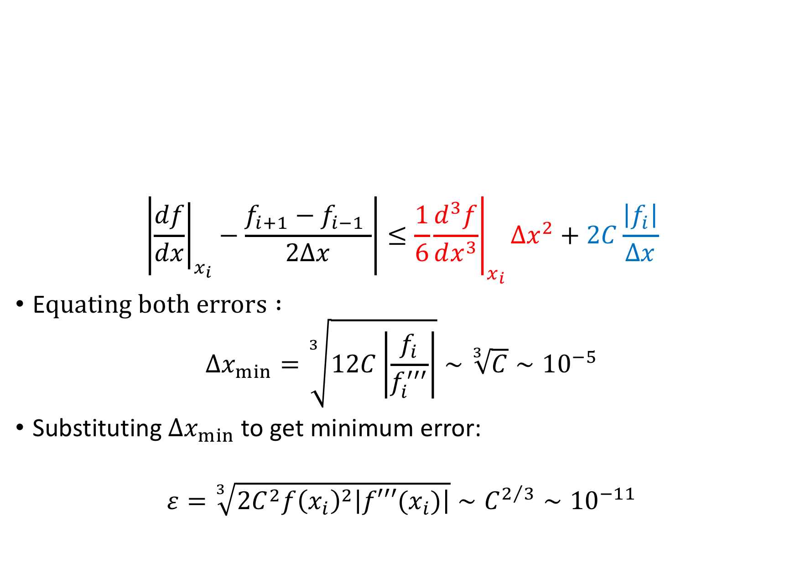

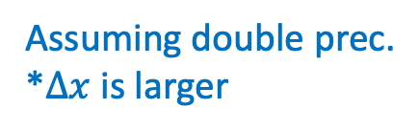
Adding the round-off error:
$$\left|{\left.\frac{df}{dx}\right|}_{x_{i}}−\frac{f_{i+1}−f_{i−1} }{2Δx}\right|≤\frac{1}{6}{\left.\frac{d^{3}f}{dx^{3}}\right|}_{x_{i}}Δx^{2}+2C\frac{\left|f_{i}\right|}{Δx}$$
E$quating both errors :$
$$Δx_{min}=\sqrt[3]{12C\left|\frac{f_{i}}{f_{i}^{′′′}}\right|}∼\sqrt[3]{C}∼{10}^{−5}$$
Substituting $Δx_{min}$to get minimum error:
$$ε=\sqrt[3]{2C^{2}f{\left(x_{i}\right)}^{2}\left|f′′′(x_{i})\right|}∼C^{2/3}∼{10}^{−11}$$
Assuming double prec.
*$Δx$ is larger
Assuming double prec.
* $ε$ is smaller
Notes:
The roundoff error will be calculated in the same way, all we did is changed f_i with f_i-1
So the minimal Delta x will be calculated again by equating the truncation and roundoff errors, , now it’ll depend on C^1/3
And the minimal error will go like C^2/3 instead of C^1/2 so closer to be linear with C.
Central derivative gives smaller minimal errors than forward or backward errors.
Note that to get the optimal error you need to calibrate your Delta x according to your accuracy.

Slide 16
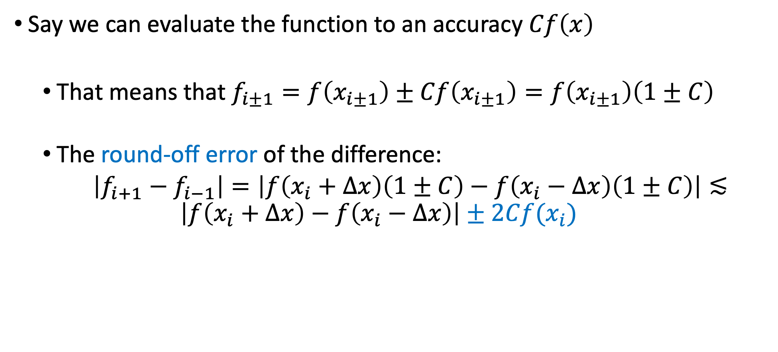
Estimating the roundoff error
Say we can evaluate the function to an accuracy $Cf\left(x\right)$
That means that $f_{i±1}=f\left(x_{i±1}\right)±Cf\left(x_{i±1}\right)=f\left(x_{i±1}\right)\left(1±C\right)$
The round-off error of the difference:
$\left|f_{i+1}−f_{i−1}\right|=\left|f\left(x_{i}+Δx\right)\left(1±C\right)−f\left(x_{i}−Δx\right)\left(1±C\right)\right|≲$
$$\left|f\left(x_{i}+Δx\right)−f\left(x_{i}−Δx\right)\right|±2Cf(x_{i})$$
Notes:
To evaluate Delta x _ min, we compare the truncation to the roundoff error, the logic is that the truncation error drops smaller delta x while the roundoff error increases. So the sweet spot will be where both are equal.
the minimal error is obtained by substituting Delta x min in the expression, to obtain an error that is a square of C, so for small roundoff errors the total error is actially larger.

Slide 17
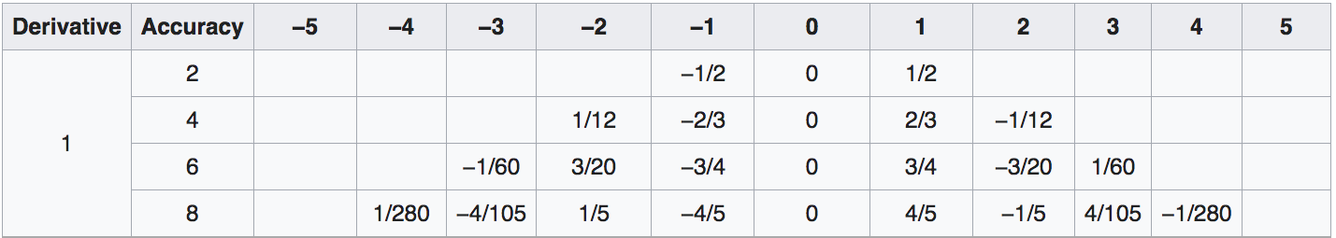
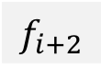
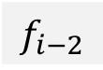
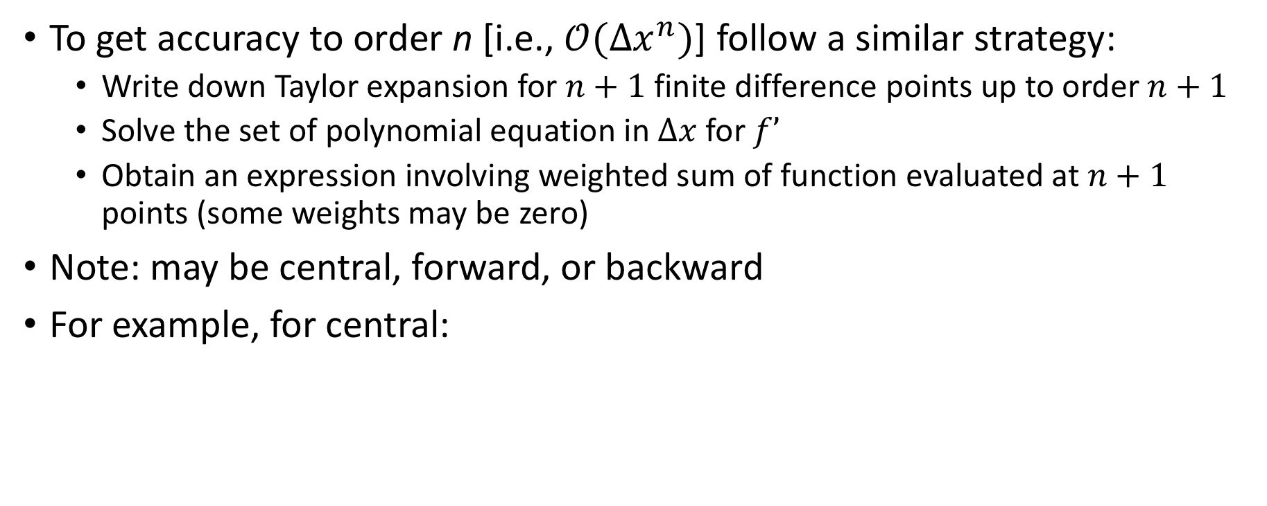
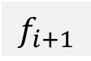
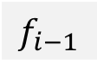

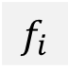

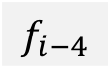
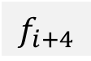

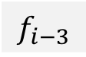
Higher order first derivatives
To get accuracy to order n [i.e., $𝒪(Δx^{n})$] follow a similar strategy:
Write down Taylor expansion for $n+1$ finite difference points up to order $n+1$
Solve the set of polynomial equation in $Δx$ for $f’$
Obtain an expression involving weighted sum of function evaluated at $n+1$ points (some weights may be zero)
Note: may be central, forward, or backward
For example, for central:
$$f_{i−5}$$
$$f_{i−4}$$
$$f_{i−3}$$
$$f_{i−2}$$
$$f_{i−1}$$
$$f_{i}$$
$$f_{i+1}$$
$$f_{i+2}$$
$$f_{i+3}$$
$$f_{i+4}$$
$$f_{i+5}$$
https://en.wikipedia.org/wiki/Finite_difference_coefficient
Notes:
Accuracy vs. time for calculation

Slide 18
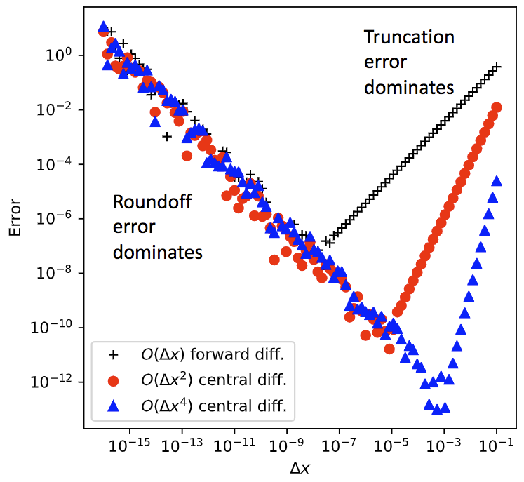
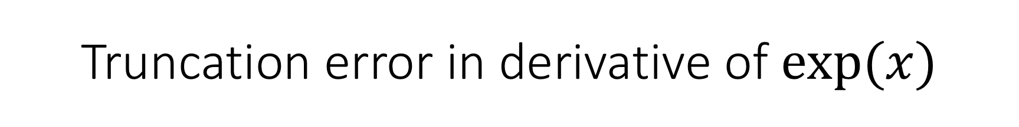
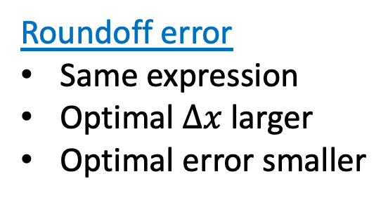
Truncation error in derivative of $exp⁡(x)$
Roundoff error
Same expression
Optimal $Δx$ larger
Optimal error smaller
Truncation error
Steeper slope
Notes:
the roundoff error (left side) is the same for all expressions, the only difference is that the optimal delta x is larger

Slide 19
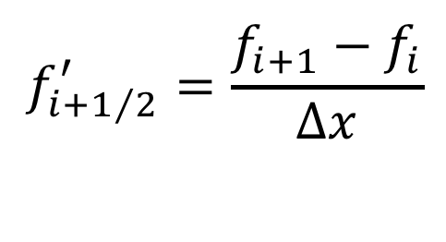
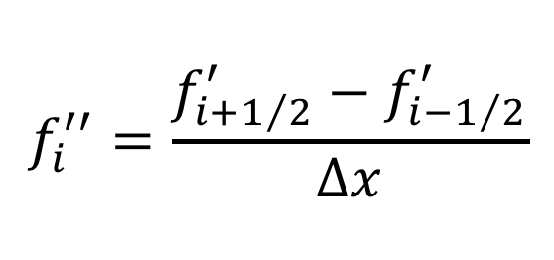
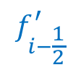
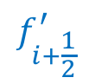
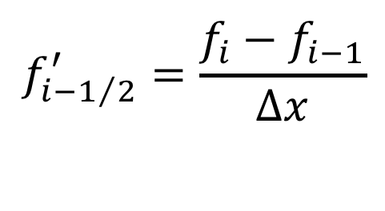
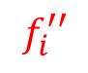

Higher order derivatives and errors
$$f_{i−\frac{1}{2}}^{′}$$
$$f_{i+\frac{1}{2}}^{′}$$
$$f_{i}^{′′}$$
x
x
$$f_{i}^{′′}=\frac{f_{i+1/2}^{′}−f_{i−1/2}^{′}}{Δx}$$
Write the second derivative as:
Substitute first order derivatives: ;
We obtain:
$$f_{i+1/2}^{′}=\frac{f_{i+1}−f_{i}}{Δx}$$
$$f_{i−1/2}^{′}=\frac{f_{i}−f_{i−1}}{Δx}$$
$$f_{i}^{′′}=\frac{f_{i+1}−2f_{i}+f_{i−1}}{Δx^{2}}$$
Notes:
Now we calculate f’’ based on f’ at the center of two sections
for the second order derivative I need 3 points!

Slide 20

Higher order derivatives and errors
Alternatively, consider the two Taylor expansions:
$${f_{i+1}=f}_{i}+f_{i}^{′}Δx+\frac{1}{2}f_{i}^{′′}Δx^{2}+\frac{1}{6}f_{i}^{′′′}Δx^{3} +\frac{1}{24}f_{i}^{′′′′}Δx^{4}+_{…}$$
$${f_{i−1}=f}_{i}−f_{i}^{′}Δx+\frac{1}{2}f_{i}^{′′}Δx^{2}−\frac{1}{6}f_{i}^{′′′}Δx^{3}+\frac{1}{24}f_{i}^{′′′′}Δx^{4}+_{…}$$

Slide 21

Higher order derivatives and errors
A second way: consider the two Taylor expansions:
$${f_{i+1}=f}_{i}+f_{i}^{′}Δx+\frac{1}{2}f_{i}^{′′}Δx^{2}+\frac{1}{6}f_{i}^{′′′}Δx^{3} +\frac{1}{24}f_{i}^{′′′′}Δx^{4}+_{…}$$
$${f_{i−1}=f}_{i}−f_{i}^{′}Δx+\frac{1}{2}f_{i}^{′′}Δx^{2}−\frac{1}{6}f_{i}^{′′′}Δx^{3}+\frac{1}{24}f_{i}^{′′′′}Δx^{4}+_{…}$$
Add together and rearrange:
$$f_{i}^{′′}=\frac{f_{i+1}−2f_{i}+f_{i−1}}{Δx^{2}}−\frac{1}{12}f_{i}^{′′′′}Δx^{2}$$
+

Slide 22

Higher order derivatives and errors
A second way: consider the two Taylor expansions:
$${f_{i+1}=f}_{i}+f_{i}^{′}Δx+\frac{1}{2}f_{i}^{′′}Δx^{2}+\frac{1}{6}f_{i}^{′′′}Δx^{3} +\frac{1}{24}f_{i}^{′′′′}Δx^{4}+_{…}$$
$${f_{i−1}=f}_{i}−f_{i}^{′}Δx+\frac{1}{2}f_{i}^{′′}Δx^{2}−\frac{1}{6}f_{i}^{′′′}Δx^{3}+\frac{1}{24}f_{i}^{′′′′}Δx^{4}+_{…}$$
Add together and rearrange:
$$f_{i}^{′′}=\frac{f_{i+1}−2f_{i}+f_{i−1}}{Δx^{2}}−\frac{1}{12}f_{i}^{′′′′}Δx^{2}$$
Combining with the round-off error: $4C{\left|f_{i}\right|}/{Δx^{2}}$ the minimal error:
$$ε=\sqrt{\frac{2}{3}C\left|f_{i}f_{i}^{′′′′}\right|}∼\sqrt{C}∼{10}^{−8}$$
+
Assuming double prec.
Notes:
To calculate the roundoff error we replace each f_i with f_i (1\pmC) , you see that in the expression of f’’ there is a division in (Delta x)^2 so the roundoff error for
the whole expression will depend on C/Delta x^2.

Slide 23

Partial and mixed derivatives
Partial derivatives are a simple generalization
E.g., central differences for function of two variables $f(x,y)$
$\frac{∂f}{∂x}=\frac{f\left(x+Δx,y\right)−f(x−Δx,y)}{2Δx}$ $\frac{∂f}{∂y}=\frac{f\left(x,y+Δy\right)−f(x,y−Δy)}{2Δy}$

Slide 24






Partial and mixed derivatives
Partial derivatives are a simple generalization
E.g., central differences for function of two variables $f(x,y)$
$\frac{∂f}{∂x}=\frac{f\left(x+Δx,y\right)−f(x−Δx,y)}{2Δx}$ $\frac{∂f}{∂y}=\frac{f\left(x,y+Δy\right)−f(x,y−Δy)}{2Δy}$
$$f\left(x,y+Δy\right)$$
$$f\left(x,y\right)$$
$$f\left(x−Δx,y\right)$$
$$f\left(x+Δx,y\right)$$
$$f\left(x,y−Δy\right)$$

Slide 25

Partial and mixed derivatives
Mixed second derivative
$$\frac{∂^{2}f}{∂x∂y}=\frac{f\left(x+Δx,y+Δy\right)−f\left(x−Δx,y+Δy\right)−f\left(x+Δx,y−Δy\right)+f(x−Δx,y−Δy)}{4ΔxΔy}$$

Slide 26







Partial and mixed derivatives
Mixed second derivative
$$\frac{∂^{2}f}{∂x∂y}=\frac{f\left(x+Δx,y+Δy\right)−f\left(x−Δx,y+Δy\right)−f\left(x+Δx,y−Δy\right)+f(x−Δx,y−Δy)}{4ΔxΔy}$$
$$f\left(x−Δx,y+Δy\right)$$
$$f^{′}\left(x,y+Δy\right)$$
$$f\left(x+Δx,y+Δy\right)$$
$$f\left(x,y\right)$$
$$f\left(x−Δx,y−Δy\right)$$
$$f^{′}\left(x,y−Δy\right)$$
$$f\left(x+Δx,y−Δy\right)$$
Notes:
In higher order derivative we first make two derivatives of first order but at cell face and then take the second derivative in the perpendicular direction..

Slide 27





Partial and mixed derivatives
Mixed second derivative
$$\frac{∂^{2}f}{∂x∂y}=\frac{f\left(x+Δx,y+Δy\right)−f\left(x−Δx,y+Δy\right)−f\left(x+Δx,y−Δy\right)+f(x−Δx,y−Δy)}{4ΔxΔy}$$
$$f\left(x−Δx,y+Δy\right)$$
$$f\left(x+Δx,y+Δy\right)$$
$$f^{′}\left(x−Δx,y\right)$$
$$f\left(x,y\right)$$
$$f^{′}\left(x+Δx,y\right)$$
$$f\left(x−Δx,y−Δy\right)$$
$$f\left(x+Δx,y−Δy\right)$$
Notes:
same way if we firsr do erivative on the vertical direction and then take a second derivative in the horizontal direction.

Slide 28


Final comments on numerical integration
Taking derivatives of noisy data makes the noise worse!
Fit to a smooth curve and take the derivative of that
Smooth the data, e.g., with a Fourier transform
We can treat data on uneven grids with the same strategy as before, taking into account the different $Δx$’s between points

Slide 29

Numerical integration

Slide 30

Basic strategy
Quadrature rule: method that represents the integral as a (weighted) sum at a discrete number of points
Newton-Cotes quadrature: Fixed spacing between points
Discretize: Break up the interval into sub- intervals
Approximate the area under the curve in a subinterval by a simple polygon (rectangle, trapezoid) or a simple function (polynomial)
Sum the areas of the subintervals
Converge the integral by making more and more subintervals or using a more sophisticated weighting method.
Notes:
Quadrature means calculating the area by taking a quare with the same area.
Squering the problem. Squaring the circle is a real well known Greek problem.
In the middle age the method evolved to tiling the surface to any small shape anc sum them up.

Slide 31




Approach 1: Midpoint rule
Approximate the area as rectangles with height equal to the midpoint of the subinterval $f(x_{i}+1/2$) and width $Δx$:
$$f(x)$$
$$x$$
Notes:
the problem in this method is that the errors can accumiulate to a klarge sum

Slide 32






Approach 2: Trapezoid rule
Area of subintervals approximated as a trapezoid with subinterval endpoints on the curve.
$$\int_{a}^{b}{f\left(x\right)dx=\lim_{N→∞}{\sum_{i=0}^{N−1}{Δx\frac{f_{i+1}+f_{i}}{2}}}}$$
$$A_{i}=Δx\frac{f_{i+1}+f_{i}}{2}$$
$$f(x)$$
$$f_{i}$$
$$f_{i+1}$$
$$Δx$$
$$x$$
Notes:
the error here is smaller.

Slide 33


A more accurate technique: Simpson’s Rule
Approximate area of each subinterval by area under a parabola passing through points $f(x_{i})$, $f(x_{i+1/2})$,$f(x_{i+1})$
Notes:
For the parapolic estimate we need 3 points

Slide 34

A more accurate technique: Simpson’s Rule

Slide 35


Where does Simpson’s rule come from?
Consider the parabolic curve:
$$g\left(x\right)=Ax^{2}+Bx+C$$
We require it passes through the endpoints and midpoint of our function $f(x_{i})$:
$$g\left(x_{i}\right)=Ax_{i}^{2}+Bx_{i}+C=f(x_{i})$$
$$g\left(x_{i+1/2}\right)=Ax_{i+1/2}^{2}+Bx_{i+1/2}+C=f(x_{i+1/2})$$
$$g\left(x_{i+1}\right)=Ax_{i+1}^{2}+Bx_{i+1}+C=f(x_{i+1})$$
Solve for $A,B,C$

Slide 36


Where does Simpson’s rule come from?
Solve for $A,B,C$
Integrate over the subinterval:

Slide 37

The errors in the three methods
Midpoint
Trapezoid
Simpson
For the Simpson's rule we need half of the slabs we need in the Trapezoid rule

Slide 38


The errors of the three methods
The error in the midpoint and trapezoid methods go as
The error in the Simpson’s method goes as
$$\int_{a}^{b}{f\left(x\right)dx}=\frac{Δx}{2}\lim_{N→∞}{\sum_{i=0}^{N−1}{\left(f_{i+1}+f_{i}\right)}+𝒪(Δx^{2})}$$
$$\int_{a}^{b}{f\left(x\right)dx}=\frac{Δx}{3}\lim_{N→∞}{\sum_{i=0}^{N/2−1}{\left(f_{2i}+4f_{2i+1}+f_{2i+2}\right)}+𝒪(Δx^{4})}$$

Slide 39

Example, calculating the integral of $1+\frac{1}{4}x\sin{(πx)}$
Defining the numerical integrators:
def I_trapezoind(x):
# number of bins, one less than number of points
N = len(x)-1
I = 0.0
# loop over bins
for n in range(N):
dx = x[n+1] - x[n]
I += dx/2.0 * (f(x[n]) + f(x[n+1])
return I
def I_simpson(x):
# number of bins, one less than number of points
N = len(x)-1
# we require an even number of bins
assert N % 2 == 0
I = 0.0
# loop over bins
for n in range(0, N-1, 2):
dx = x[n+1] - x[n]
I += dx/3.0 * (f(x[n])+ 4 * f(x[n+1]) + f(x[n+2]))
return I

Slide 40



Example, calculating the integral of $1+\frac{1}{4}x\sin{(πx)}$
Lets calculate the integral between $a=0.5$ , $b=1.5$ dividing the interval into $N=\left\{2, 4, 8, 16, 32, 64, 128, 256\right\}$ bins.
We then calculate the errors from the analytic solution
$$I_{a}=1−\frac{1}{2π^{2}}$$
N = [2, 4, 8, 16, 32, 64, 128, 256]
err_trap = []
err_simps = []
for nbins in N:
x = np.linspace(a, b, nbins+1)
err_trap.append(np.abs(I_t(x) - I_a))
err_simps.append(np.abs(I_s(x) - I_a))

Slide 41


Example, calculating the integral of $1+\frac{1}{4}x\sin{(πx)}$
The integrated area
The error

Slide 42

Errors in Newton-Cotes quadrature integration
Error can be reduced by increasing the order of the polynomial or increasing the number of subintervals
We can estimate errors in a similar way as we did for numerical differentiation (Taylor expand around points and take integrals), see, e.g., Newman Section 5.2.
For example, for the trapezoid rule:
$$ε=\frac{1}{12}Δx^{2}\left[f^{′}\left(x_{1}\right)−f′(x_{2})\right]$$
This is the Euler-Maclaurin formula for the error on the trapezoidal rule.
If we know the derivatives at the endpoints, we can calculate the error

Slide 43

Choosing the number of steps
Estimating the error without knowing $f’\left(x\right):$
Perform the integration with $N_{1}$ and $N_{2}=2N_{1}$subintervals.
In the trapezoid rule, the error using $N_{1}$ will be 4 times that using $N_{2}$
The “exact” result, $I$ is: $I=I_{1}+cΔx_{1}^{2}=I_{2}+cΔx_{2}^{2}$
Since $Δx_{1}^{2}=4Δx_{2}^{2}, t$he error on the second estimate is:
$$ε_{2}=cΔx_{2}^{2}=\frac{1}{3}\left(I_{2}−I_{1}\right)$$
We can use this approach to decide when our integral is converged
Double the number of subintervals until the error is small enough.
Can use the results from previous function evaluations (See Newman Sec. 5.3
and 5.4 or Garcia Sec. 10.2)

Slide 44

Romberg Integration
If $n$ is a step in the procedure on the previous slide (i.e. doubling the number of subintervals), we can write the integral as:
$$I=I_{n}+ε_{n}=I_{n}+\frac{1}{3}\left(I_{n}−I_{n−1}\right)+𝒪(Δx_{n}^{4})$$
As accurate as Simpson’s rule!
For every additional step (doubling of subintervals), we can build more and more accurate estimates
See Newman Sec. 5.4 or Garcia Sec. 10.2 for more details
Notes:
Notice that here n is the power in 2 of the steps.

Slide 45

Integrals over infinite ranges (Newman Sec. 5.8)
If we need to integrate over half of the real numbers interval:
$$I=\int_{0}^{∞}{f\left(x\right)dx}$$
Impractical to simply increase the upper bound until convergence.
Instead, make a change of variables:
$$z≡\frac{x}{x+1 }⟺x=\frac{z}{1−z} ⟹ dx=\frac{dz}{{\left(1−z\right)}^{2}}$$
Now the interval becomes final:
$$I=\int_{0}^{1}{\frac{f\left(\frac{z}{1−z}\right)}{{\left(1−z\right)}^{2}}dz}$$

Slide 46

Beyond Newton-Cotes: Gaussian Quadrature
As an extra degree of freedom, lets vary the space between integration points
We must first determine integration rules for unequal spacing
We need to determine weights:
$$\int_{x_{1}}^{x_{N}}{f\left(x\right)dx=w_{1}f\left(x_{1}\right)+_{…. }+w_{N}f(x_{N})}$$
Trapezoidal (evenly spaced):
$$\int_{x_{1}}^{x_{N}}{f\left(x\right)dx=\frac{1}{2}f\left(x_{1}\right)+f\left(x_{2}\right)+_{…}+f\left(x_{N−1}\right)+\frac{1}{2}f(x_{N})}$$
Simpson (evenly spaced):
$$\int_{x_{1}}^{x_{N}}{f\left(x\right)dx=\frac{1}{6}f\left(x_{1}\right)+\frac{2}{3}f\left(x_{1.5}\right)+\frac{1}{2}f\left(x_{2}\right)+\frac{2}{3}f\left(x_{2.5}\right)+_{…}+\frac{2}{3}f\left(x_{N−0.5}\right)+\frac{1}{6}f(x_{N})}$$
Notes:
Inmtegral is just a series of functions at designated points plus weights.

Slide 47

Beyond Newton-Cotes: Gaussian Quadrature
The weights will be associated to a particular set of nonuniform points.
Done thorough Gaussian quadrature (Garcia sec 10.3 ; Newman sec. 5.6).
Let $q(x)$ be a polynomial of degree $N$ such that:
$$\int_{a}^{b}{q\left(x\right)ρ\left(x\right)x^{k}dx=0}$$
$k=0,…,N−1$ and $ρ(x)$ is a specified weight function.
Choose $x_{1},…,x_{N}$as the roots of the polynomial $q(x)$, and use them as grid points:
$$\int_{a}^{b}{f\left(x\right)ρ\left(x\right)dx≃w_{1}f\left(x_{1}\right){+w_{2}f\left(x_{2}\right)+}_{….}+w_{N}f(x_{N})}$$
There exists a set of $w$’s where this formula is exact if $f(x)$is a polynomial of degree < 2N
Note that with N values, we can fit an N-1 degree polynomial and derive an integration formula exact for polynomials of order <N
Many choices of weighting function, $ρ(x)$, leading to different $q(x)$ and $x_{i}$ and $w_{i}$

Slide 48

Example: Three-point Gauss-Legendre rule
A three grid points integral over the interval $[−1,1].$
Take the weight function $ρ\left(x\right)=1$, gives a Gaussian-Legendre formula.
The grid points are the routs of the integral
$$\int_{a}^{b}{q\left(x\right)x^{k}dx=0,}$$
We want 3 grid points, so $k=0, 1, 2$ and
$q\left(x\right)=c_{0}+c_{1}x+c_{2}x^{2}+c_{3}x^{3},$
We can convert an arbitrary interval $[a,b]$ to $[−1,1]$with
$$x=\frac{1}{2}\left(b+a\right)+\frac{1}{2}\left(b−a\right)z ⟹ dx=\frac{1}{2}\left(b−a\right)dz$$
$$\int_{a}^{b}{f\left(x\right)dx= \frac{b−a}{2}\int_{−1}^{1}{f\left(z\right)dz}}$$

Slide 49




Step 1: Find the polynomial $q(x)$
$q\left(x\right)=c_{0}+c_{1}x+c_{2}x^{2}+c_{3}x^{3},$
Applying the theorem to get three equations for the coefficients:
General solution:
$$2c_{0}+\frac{2}{3}c_{2}=\frac{2}{3}c_{1}+\frac{2}{5}c_{3}=\frac{2}{3}c_{0}+\frac{2}{5}c_{2}=0$$
Giving:
$$c_{0}=0 ;{ c}_{1}=−a ;{ c}_{2}=0 ;{ c}_{3}={5a}/3$$
$a$is an arbitrary constant.
If we take $a=\frac{3}{2}$ we get the Legendre Polynomial $P_{3}\left(x\right):$
$$q\left(x\right)=−\frac{3}{2}x+\frac{5}{2}x^{3}$$
$$\int_{−1}^{1}{q\left(x\right)dx}=0$$
$$\int_{−1}^{1}{xq\left(x\right)dx=0}$$
$$\int_{−1}^{1}{x^{2}q\left(x\right)dx=0}$$

Slide 50


Step 2: Find the roots of $q(x)$
$$q\left(x\right)=−\frac{3}{2}x+\frac{5}{2}x^{3}$$
Easily factors to:
$$x_{i}=0 , ±\sqrt{\frac{3}{5}}$$
The quadrature then becomes:
$$\int_{−1}^{1}{f\left(x\right)dx=w_{1}f\left(−\sqrt{3/5}\right)+w_{2}f\left(0\right)+w_{3}f\left(\sqrt{3/5}\right)}$$

Slide 51


Step 3: Find the weights
Theorem: The quadrature is exact for polynomials up to degree $2N−1$
Start with $f\left(x\right)=1:$
Now $f\left(x\right)=x:$
Finally $f\left(x\right)=x^{2}$:
Solve to get:
$$\int_{−1}^{1}{dx=2=w_{1}+w_{2}+w_{3}}$$
$$\int_{−1}^{1}{xdx=0={−\sqrt{3/5}w}_{1}+{0w}_{2}+{\sqrt{3/5}w}_{3}}$$
$$\int_{−1}^{1}{x^{2}dx=\frac{2}{3}={\frac{3}{5}w}_{1}+{0w}_{2}+{\frac{3}{5}w}_{3}}$$
$$w_{1}=\frac{5}{9}, w_{2}=\frac{8}{9}, w_{3}=\frac{5}{9}$$

Slide 52

Step 4: Put it together
3 point Gauss-Legendre quadrature:
$$\int_{−1}^{1}{f\left(x\right)dx≃\frac{5}{9}f(−\sqrt{3/5}})+\frac{8}{9}f\left(0\right)+\frac{5}{9}f(\sqrt{3/5})$$

Slide 53

Example: Error function
$$\operatorname{erf}\left(x\right)=\frac{2}{\sqrt{π}}\int_{0}^{1}{e^{−y^{2}}dy}$$
Evaluate erf(1):
Exact: 0.8427007929497148
3-point Trapezoid: 0.8252629555967492 , Error: -0.017437837352965557
3-point Simpsons: 0.843102830042981 , Error: 0.0004020370932662498
3-point Gauss-Legendre: 0.8426900184845107 , Error: -1.0774465204033135e-05

Slide 54

Example: 5th degree polynomial
$$I=\int_{0}^{1}{\left(1+x^{2}+x^{3}+x^{4}+x^{5}\right)dx}$$
Exact: 2.4499999999999997
3-point Trapezoid: 2.734375 , Error: 0.28437500000000027
3-point Simpsons: 2.4791666666666665 , Error: 0.029166666666666785
3-point Gauss-Legendre: 2.45 , Error: 4.440892098500626e-16

Slide 55


Weights and grid points have been tabulated
Table 10.7: Grid points and weights for Gauss-Legendre integration.
From Garcia 10.3:
From Newman Sec. 5.6:
Points and weights for Gaussian quadrature with N=10 (left) and N=100 (right)

Slide 56


Other types of Gaussian Quadrature
Orthogonal polynomial $q\left(x\right)$ for different types of weight function $ρ(x)$ in the integral $\int_{a}^{b}{q\left(x\right)f(x)dx}$
Interval | $$ρ(x)$$ | Orthogonal polynomials | Equations given in A & S | For more information
$$[−1, 1]$$ | $$1$$ | Legendre polynomials | 25.4.29 | Gauss–Legendre quadrature
$$(−1, 1)$$ | $${\left(1−x\right)}^{α}{\left(1+x\right)}^{β}$$ $$α,β>−1$$ | Jacobi polynomials | 25.4.33 (β = 0) | Gauss–Jacobi quadrature
$$(−1, 1)$$ | $$\frac{1}{\sqrt{1−x^{2}}}$$ | Chebyshev polynomials (1’st kind) | 25.4.38 | Chebyshev–Gauss quadrature
$$[−1, 1]$$ | $$\sqrt{1−x^{2}}$$ | Chebyshev polynomials (2’nd kind) | 25.4.40 | Chebyshev–Gauss quadrature
$$[0, ∞)$$ | $$e^{−x}$$ | Laguerre polynomials | 25.4.45 | Gauss–Laguerre quadrature
$$[0, ∞)$$ | $$x^{α}e^{−x} , α>−1$$ | Generalized Laguerre polynomials |  | Gauss–Laguerre quadrature
$$(−∞, ∞)$$ | $$e^{−x^{2}}$$ | Hermite polynomials | 25.4.46 | Gauss–Hermite quadrature
(From Wikipedia)
Notes:
By setting rho we change the polinomials that spread the section we want to integrate.

Slide 57
Choosing an integration method (Newman Sec. 5.7)
Trapezoid method:
• Trivial to program
• Equally spaced points, often true of experimental data
• Good choice for poorly behaved data (noisy, singularities)
• Adaptive method gives guaranteed accuracy level
• Not very accurate for given number of points
Romberg integration:
• Equally spaced points, often true of experimental data
• Guaranteed accuracy level
• Potentially high accuracy for small number of points
• Will not work well for noisy of pathological data/integrands
Gaussian Quadrature
• Potentially high accuracy for small number of points
• Simple to program (weights and roots tabulated)
• Will not work well for noisy of pathological data/integrands
• Need to have data on specific, unequally-spaced grid, where the roots are located.

Slide 58
After class tasks
If you do not already have one, make an account on github: https://github.com/
Readings:
Wikipedia article on makefiles
Good Enough Practices in Scientific Computing
Blog on numerical differentiation
Wikipedia page of finite difference coefficients
Newman Chapter 5
Garcia Section 10.2

